Slide 1

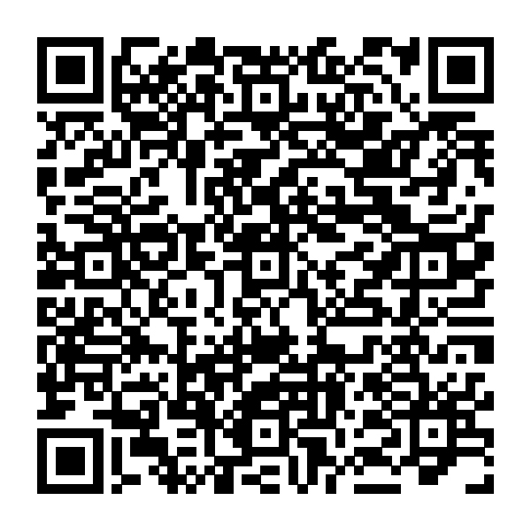
Financial resources for
the military community
Visit our Military Community Page
for curated resources on topics
important to you.
Scan the code to get started or
visit Fidelity.com/military
The Fidelity Investments logo is a registered service mark of FMR LLC.
Fidelity Brokerage Services LLC, Member NYSE, SIPC, 900 Salem Street, Smithfield, RI 02917
©2026 FMR LLC. All rights reserved.
1267704.1.0

